Slide 1
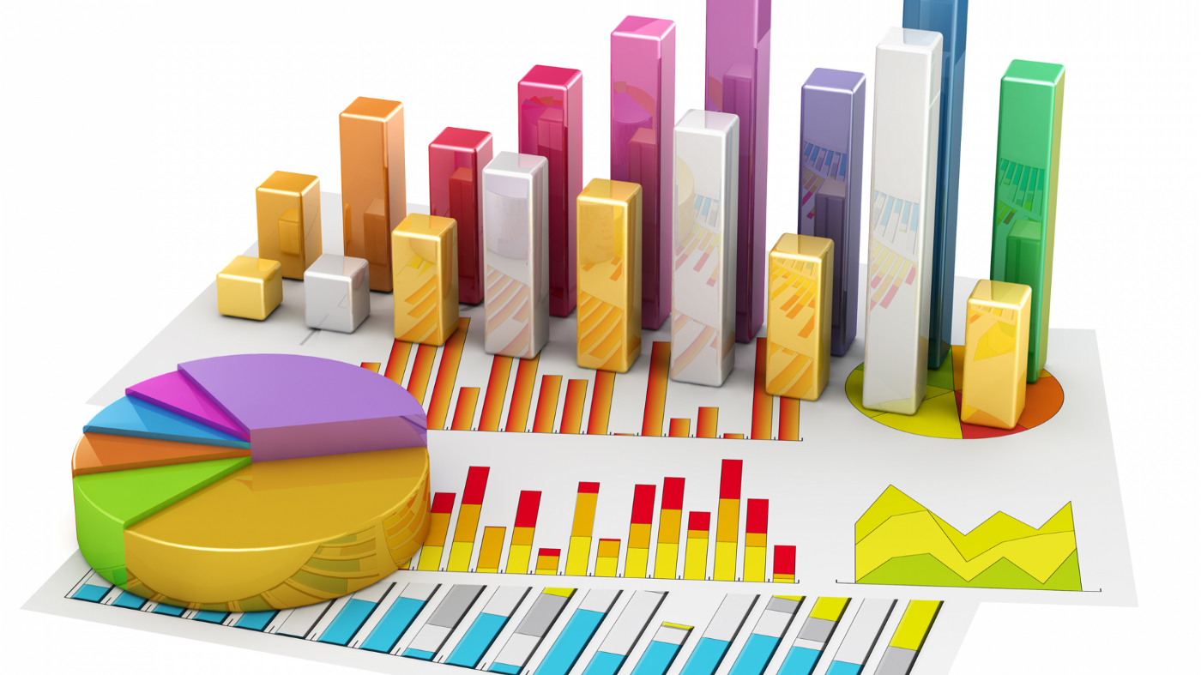
Welcome To….
Data Presentation (part -2)

Slide 2
Learning outcomes
Know the appropriate tool for data presentation
Exploring fact from data

Slide 3
Contents
Construction of Frequency Distribution for qualitative data
Graphical presentation of qualitative data
Time series data and Line graph
Uses of Diagrams

Slide 4
Tabular presentation for qualitative data
The following data give the number of shoes in different sizes sold by a shop on last one week:
L, M, S, M,M, S, L, L, S, M,M S, L, M, M, S, L, S, M, M, M, M, S, L, S, S, S, S, M, M, M, L, S, M.
Construct a frequency distribution table for this qualitative data..
Solution:
There are 34 observations having 3 categories which are ‘L’= Large, ‘M’= Medium and ‘S’=Small.
So the frequency table will be as follows:

Slide 5
Graphical presentation of frequency distribution for qualitative data
Two types of graphical presentation for qualitative data are:
1.Bar Diagram
2.Pie chart

Slide 6
Graphical presentation of frequency distribution for qualitative data
Steps to draw Bar diagram:
Show the categories on the horizontal axis.
Show the frequencies on the vertical axis.

Slide 7
Graphical presentation of frequency distribution for qualitative data
Steps to draw Pie chart:
Step 3:
Divide the whole circle proportional to the percentage of each of the categories approximately.
Step 2:
Divide the whole circle into 4 parts by using dash lines so that each portion is of 25%.
Step 1:
Draw a circle.
25%
25%
25%
25%

Slide 8
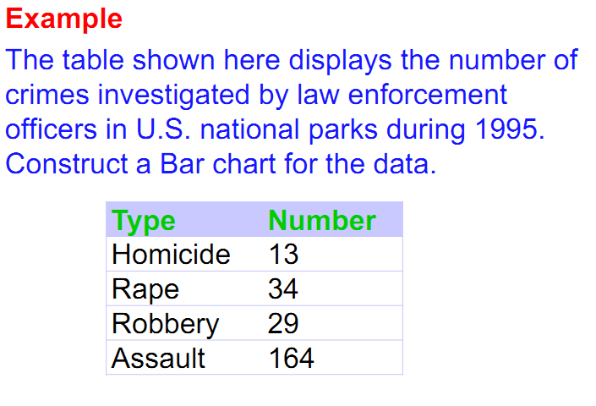
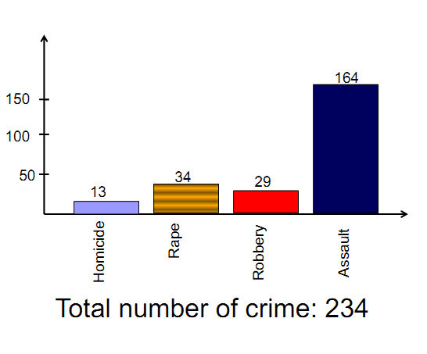
Graphical presentation of frequency distribution for qualitative data
Figure: Bar Diagram

Slide 9
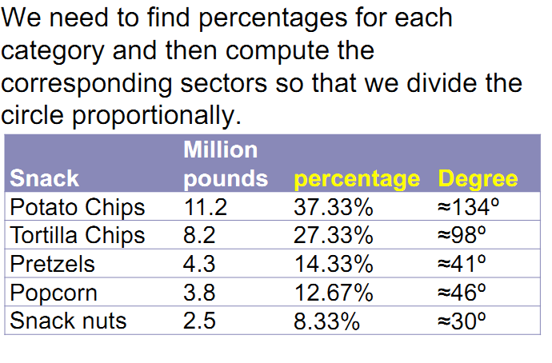
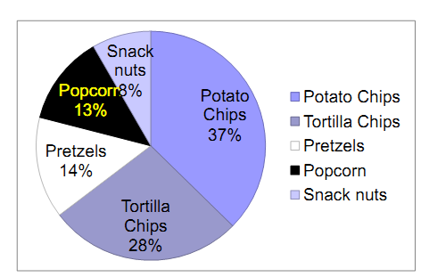
Graphical presentation of frequency distribution for qualitative data
Figure: Pie chart

Slide 10
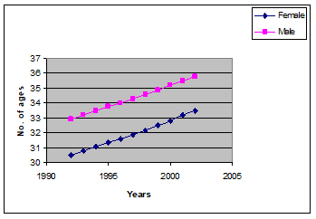
Time series data and Line Graph
Time Series Data:
A time series data is simply a series of data points ordered in time. Most commonly, a time series is a sequence taken at successive equally spaced points in time. Thus it is a sequence of discrete-time data.
Line Graph:
A line graph is a type of chart used to show information that changes over time. So Time series data can be drawn by Line Graph.
Figure: Line Diagram

Slide 11
Use of Diagrams & Differences between Histogram and Bar Diagram

Slide 12
Differences between Histogram and Bar Diagram

Slide 13
Some exercise Problems to solve
A country has four political parties say A, B ,C, D. An opinion survey was conducted on 30 people randomly. The data were obtained as follows:
B, C, A, B, A, C, D, A, A, B, C, A, B, C, D, A, A, B, C, A, B, D, A, A, A, D, C, D, B, A.
Construct a frequency distribution table.
Which one is the most popular party based on the survey?
What is the percentage of people liked party B?
Construct an appropriate graph.

Slide 14
Some exercise Problems to solve

Slide 15



